Slide 1
Chapter 1
Introduction
Operating System Concepts 7th edition - Silberchatz, Galvin, & Gagne

Slide 2
Chapter 1: Introduction
What Operating Systems Do
Computer-System Organization
Computer-System Architecture
Operating-System Structure
Operating-System Operations
Process Management
Memory Management
Storage Management
Protection and Security
Distributed Systems
Special-Purpose Systems
Computing Environments
Operating System Concepts 7th edition - Silberchatz, Galvin, & Gagne

Slide 3
Common Functions of Interrupts
Interrupt transfers control to the interrupt service routine generally, through the interrupt vector, which contains the addresses of all the service routines.
Interrupt architecture must save the address of the interrupted instruction.
Incoming interrupts are disabled while another interrupt is being processed to prevent a lost interrupt.
A trap is a software-generated interrupt caused either by an error or a user request.
An operating system is interrupt driven.
Operating System Concepts 7th edition - Silberchatz, Galvin, & Gagne

Slide 4
I/O Structure
Computer consists of CPU and multiple device controllers that are connected through common bus
Each device controller is in charge of a specific type of device
Device controller maintain local buffer and special purpose registers
Device controller moves data between the peripheral device that it controls and its local buffer storage
OS have device driver for each device controller
Device driver understands device controller and presents a uniform interface to the device to the rest of the OS
Operating System Concepts 7th edition - Silberchatz, Galvin, & Gagne

Slide 5
I/O Structure
To start I/O operation, device driver loads appropriate register within device controller
Then device controller examines contents of these registers to determine which action to take ( read a character from keyboard)
The controller starts transfer of data device to its local buffer
Once the transfer of data is complete, the controller informs the device driver via interrupt that it has finished operation
Then device driver then returns control to the OS, returning the data or pointer to the data if the operation is read
For other operations, the device driver returns status information
Operating System Concepts 7th edition - Silberchatz, Galvin, & Gagne

Slide 6
Direct Memory Access Structure
DMA stands for "Direct Memory Access."
A feature of modern computers and microprocessors that allows certain hardware subsystems within the computer to access system memory for reading and/or writing independently of the central processing unit.
DMA is a method of transferring data from the computer's RAM to another part of the computer without processing it using the CPU.
While most data that is input or output from your computer is processed by the CPU, some data does not require processing, or can be processed by another device.
In these situations, DMA can save processing time and is a more efficient way to move data from the computer's memory to other devices.
Operating System Concepts 7th edition - Silberchatz, Galvin, & Gagne

Slide 7
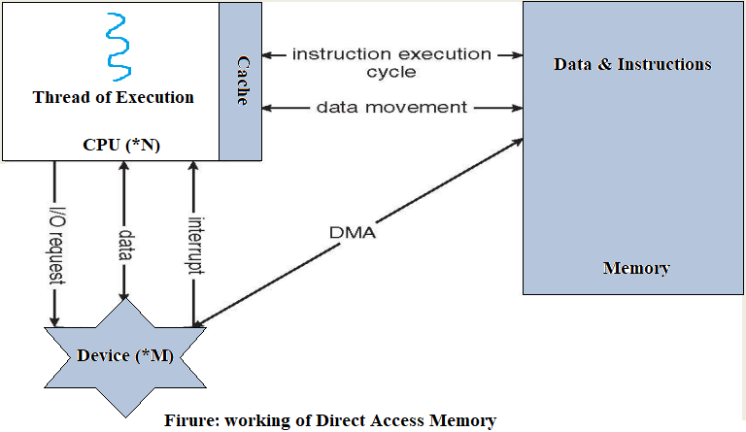
Working of DMA
Operating System Concepts 7th edition - Silberchatz, Galvin, & Gagne

Slide 8
DMA: Example
Many hardware systems use DMA including disk drive controllers, graphics cards, network cards and sound cards.
Sound card may need to access data stored in the computer's RAM, but since it can process the data itself, it may use DMA to bypass the CPU.
Video cards that support DMA can also access the system memory and process graphics without needing the CPU.
Operating System Concepts 7th edition - Silberchatz, Galvin, & Gagne

Slide 9
Storage Structure
Main memory – only large storage media that the CPU can access directly.
Secondary storage – extension of main memory that provides large nonvolatile storage capacity.
Magnetic disks – rigid metal or glass platters covered with magnetic recording material
  Disk surface is logically divided into tracks, which are subdivided into sectors.
  The disk controller determines the logical interaction between the device and the computer.
Operating System Concepts 7th edition - Silberchatz, Galvin, & Gagne

Slide 10
Storage Hierarchy
Storage systems organized in hierarchy.
  Speed
  Cost
  Volatility
Caching – copying information into faster storage system; main memory can be viewed as a last cache for secondary storage.
Operating System Concepts 7th edition - Silberchatz, Galvin, & Gagne

Slide 11

Storage-Device Hierarchy
Operating System Concepts 7th edition - Silberchatz, Galvin, & Gagne

Slide 12
Caching
Information in use copied from slower to faster storage temporarily
Faster storage (cache) checked first to determine if information is there
  If it is, information used directly from the cache (fast)
  If not, data copied to cache and used there
Cache smaller than storage being cached
  Cache management important design problem
  Cache size and replacement policy
Operating System Concepts 7th edition - Silberchatz, Galvin, & Gagne

Slide 13

Performance of Various Levels of Storage
Movement between levels of storage hierarchy can be explicit or implicit
Operating System Concepts 7th edition - Silberchatz, Galvin, & Gagne

Slide 14

Migration of Integer A from Disk to Register
Multitasking environments must be careful to use most recent value, no matter where it is stored in the storage hierarchy
Multiprocessor environment must provide cache coherency in hardware such that all CPUs have the most recent value in their cache
Distributed environment situation even more complex
  Several copies of a datum can exist
Operating System Concepts 7th edition - Silberchatz, Galvin, & Gagne

